Slide 1
Making Text for the Web
Barb Ericson
Georgia Institute of Technology
March 2006

Slide 2
Learning Goals
Media Goals
  Learn basic HTML
  Write programs that generate HTML
  Use a database to generate HTML
Computing Concepts
  Introduce hexadecimal for describing colors
  Create and use helper methods
  Throw an exception
  Introduce the “unnamed” package
  Introduce a map of keys to values
  Use generics
  Use an iterator to loop through a collection
  Introduce SQL and relational databases

Slide 3
HTML
HyperText Markup Language
  The main language used in web pages
    Not a programming language!
  Grew out of SGML
    Structured General Markup Language
  Used to describe the structure of documents
    This is a title <title>This is a title</title>
    This is a heading <h1>Heading 1</h1>
    This is a paragraph<p>Start of a new paragraph</p>
We will be using XHTML
  HTML defined in terms of XML
    XML is an eXtensible Markup Language

Slide 4
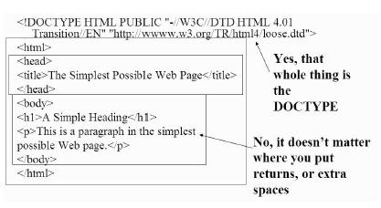
Structure of an HTML Page
DOCTYPE
Html tag
Head tag
  Title tag
Body tag
  Heading tag
  Paragraph tag
Notice the closing tags
  Start with </…> like </html>

Slide 5
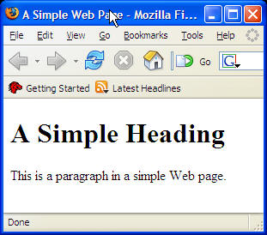
HTML Exercise
Open a simple editor (like notepad) and type in the HTML from the previous page
Save it as Simple.html
Double click on it to open in a browser

Slide 6
Headings, Style and New Line Tags
Headings
  h1 – h6
  Smaller numbers are more prominent
Style tags
  Emphasis <em>…</em>
  Italics <i>…</i>
  Bold <b>…</b>
Force a new line by adding <br />
  Note that this is just one tag not a pair of starting and ending tags

Slide 7

Inserting an Image
To insert an image use:
<image src="name.jpg" />
  If the source (src) is a file name like flower1.jpg it should be in the same directory as the HTML page
If it is a pathname
  Resolve the path relative to directory with the HTML page
src="images/flower1.jpg"
Current Directory
HTML page
flower1.jpg
Current Directory
HTML page
images directory
Notes:
You can use ../ to go up one level to the parent directory.
You can also use a url to access an image on another server.

Slide 8
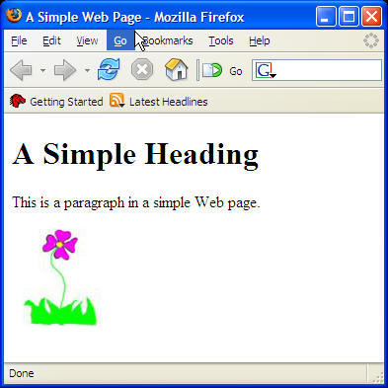
More on the Image Tag
Specify the width in pixels
  <image src="flower1.jpg" width="100" />
    The height will adjust to keep the same aspect ratio (height to width)
Specify the height in pixels
  <image src="flower1.jpg" height="50" />
    The width will adjust to keep the same aspect ratio
Specify alternative text to describe the image (for audio browsers)
  <image src="flower1.jpg" alt="flower">

Slide 9
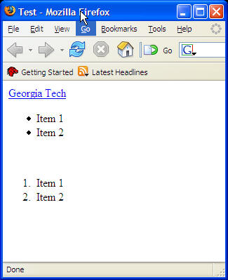
Hyperlinks and Lists
Add a Hyperlink
  <a href="some url">Text to click on</a>
Bulleted List
  <ul>
  <li>Item 1</li>
  <li>Item 2</li>
  </ul>
Numbered List
  <ol>
  <li>Item 1</li>
  <li>Item 2</li>
  </ol>
<html>
<head>
<title>Test</title>
<body>
<a href="http://www.gatech.edu">
Georgia Tech</a>
<br />
<ul>
<li>Item 1</li>
<li>Item 2</li>
</ul>
<br />
<ol>
<li>Item 1</li>
<li>Item 2</li>
</ol>
</body>
</html>

Slide 10
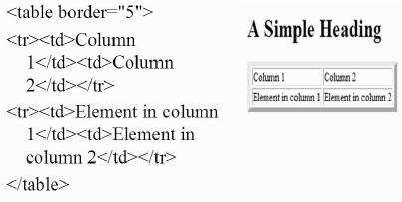
Tables
Tables <table> have rows <tr> and each row can have many table data <td> items
Tables can have borders
  border="size"
Tables can have headers
  <th>

Slide 11
Specifying Colors
Color in HTML is specified in hexadecimal
  Base 16
  Digits: 0, 1, 2, 3, 4, 5, 6, 7, 8, 9, A, B, C, D, E, F
  Use powers of 16 times the value of the digit
    A is 10, B is 11, C is 12, D is 13, E is 14, F is 15
    So 14 is (1 * 16¹) + (4 * 16⁰) = 20
    And C2 is (12 * 16¹) + (3 * 16⁰) = 195
  Each digit of hexadecimal corresponds to 4 bits
Colors are written as rrggbb
  FFFFFF is white, 000000 is black, FF0000 is red, 00FF00 is green, 0000FF is blue
Notes:
See http://www.webmonkey.com/webmonkey/reference/color_codes/ for color codes for sample colors.

Slide 12
Exercise
Create a simple HTML page with a 2 by 2 table with 4 images in the table
  Limit the height of the images in the table to 100 pixels
  Be sure to provide alternative text that describes the images
  Set the background color in the table to a pale yellow
  http://www.webmonkey.com/webmonkey/reference/color_codes/
Also include a bulleted list of 4 friends
And a hyperlink to something on the web

Slide 13
Summary
HTML is the language of the Web
  Not a programming language
Specify HTML with tags
  Most have starting tags and ending tags
    <html> … </html>
  Some items only have one tag
<image src="name.jpg" />
You can create tables and lists in HTML
  <table></table> <ul><li>1</li></ul>
You can insert images and hyperlinks

